Slide 1

Time Series Forecasting with Yahoo Stock Price

Slide 2
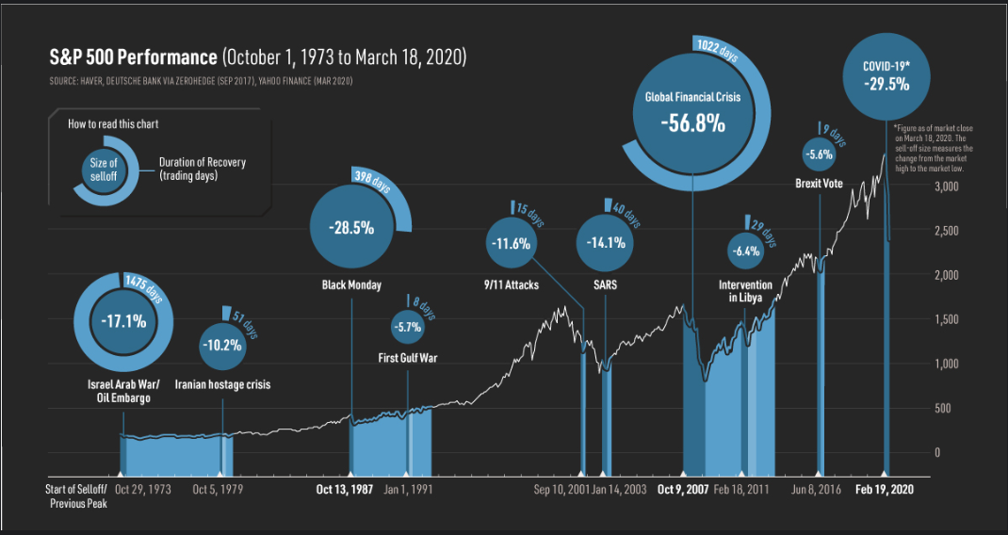

Slide 3
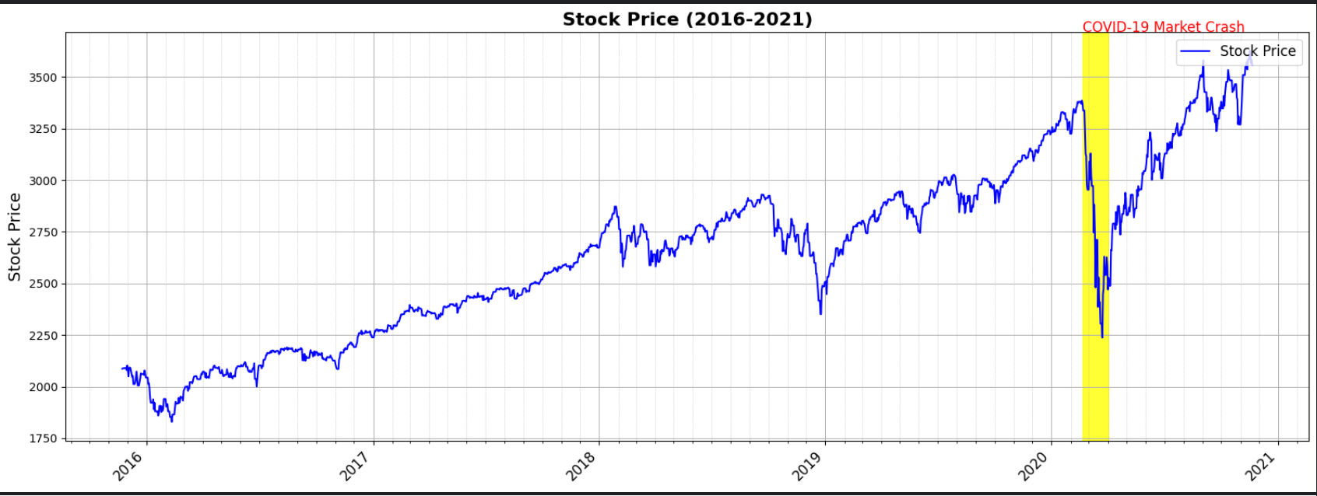

Slide 4
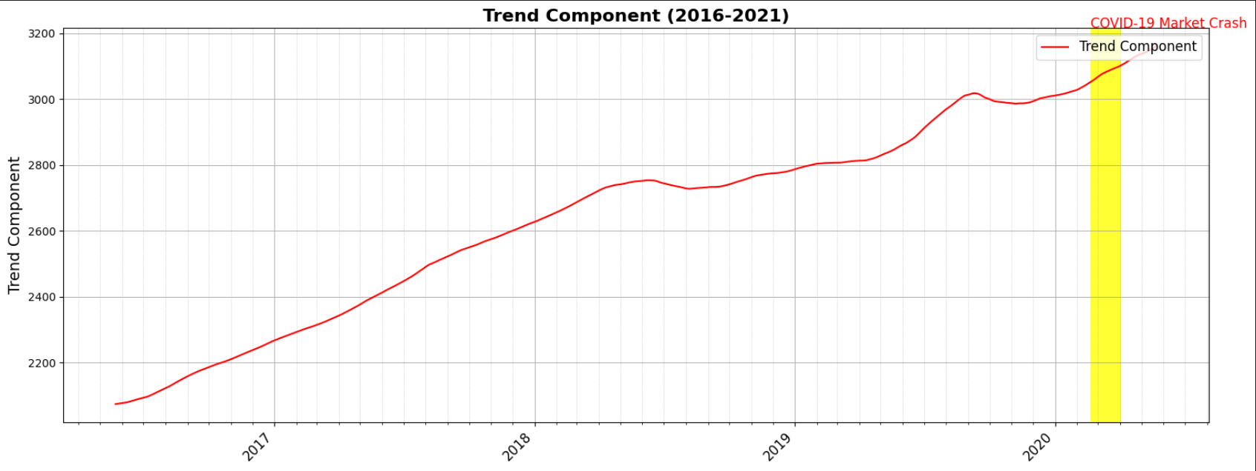

Slide 5
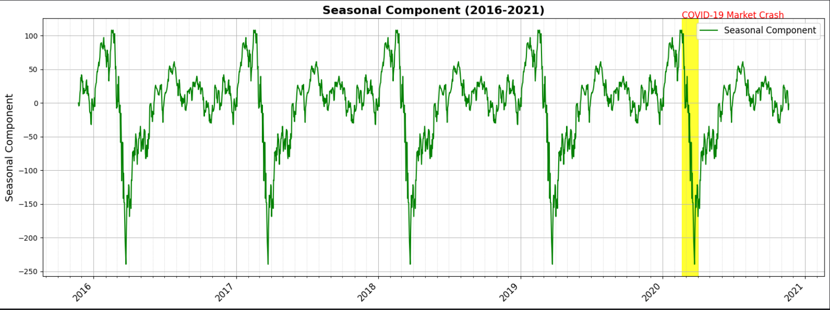

Slide 6
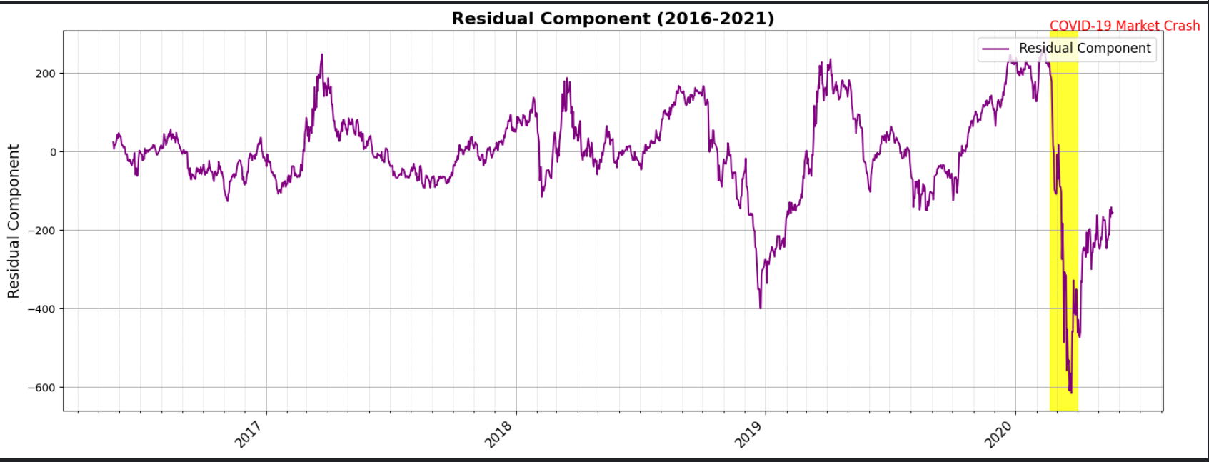

Slide 7
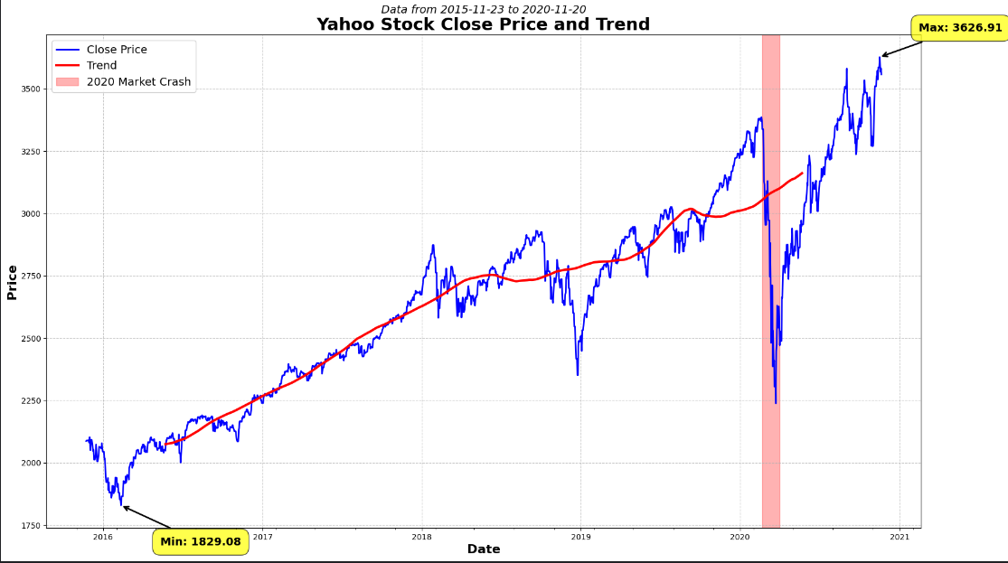

Slide 8
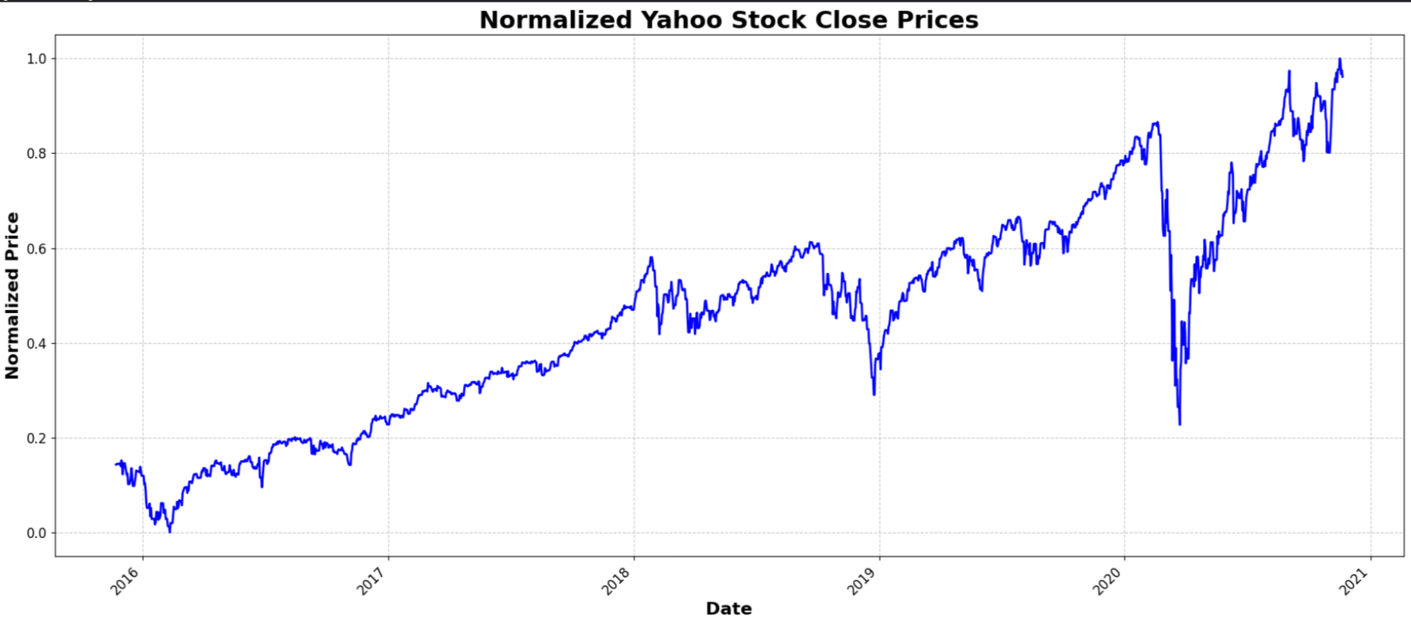

Slide 9
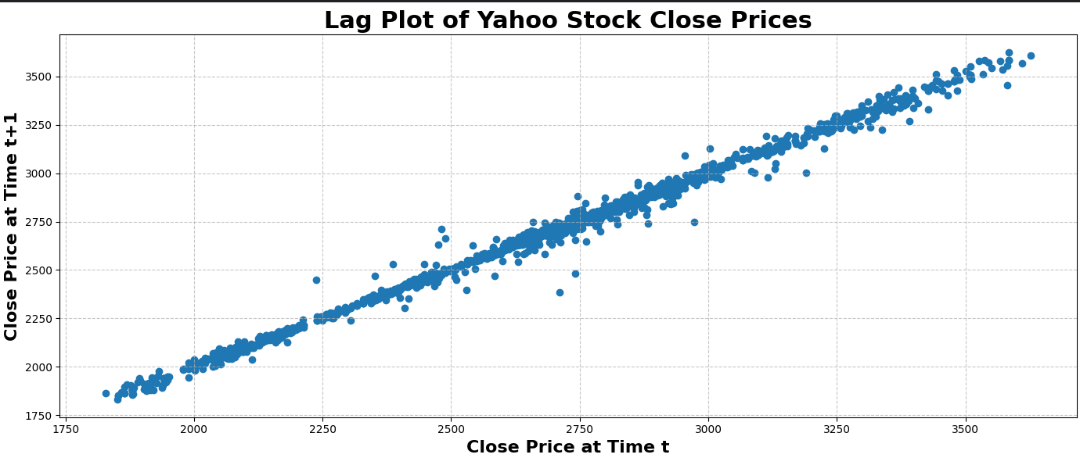
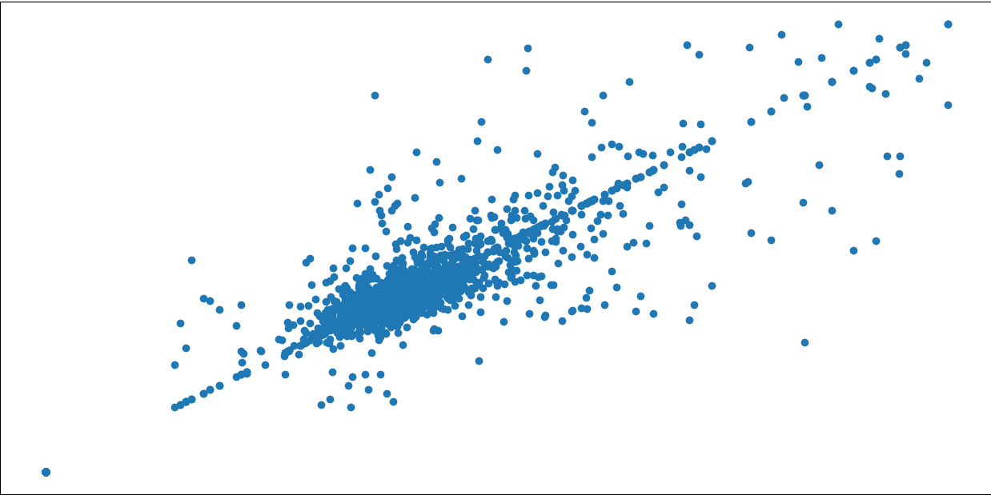

Slide 10
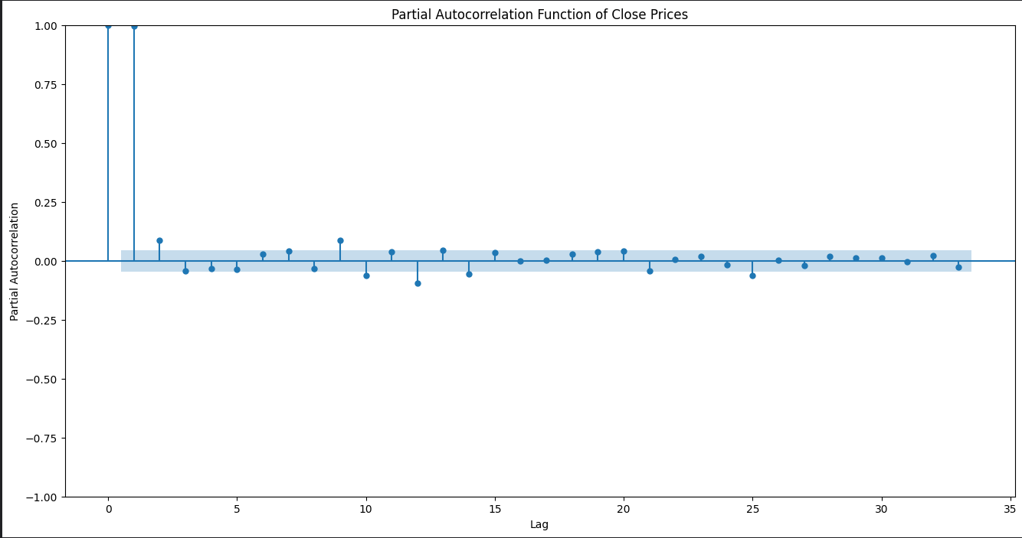

Slide 11
The strong lag 1 partial autocorrelation suggests that an AR(1) (Autoregressive model of order 1) might be appropriate for this time series.
There are no obvious cyclical or seasonal patterns visible in the PACF plot.
This PACF plot suggests that a simple model like ARIMA(1,d,q) might be suitable. Might also try ARIMA(1,d,1)
Stationarity: The rapid decay in partial autocorrelations after lag 1 is a good sign, but doesn't guarantee stationarity. You should still perform formal stationarity tests.

Slide 12
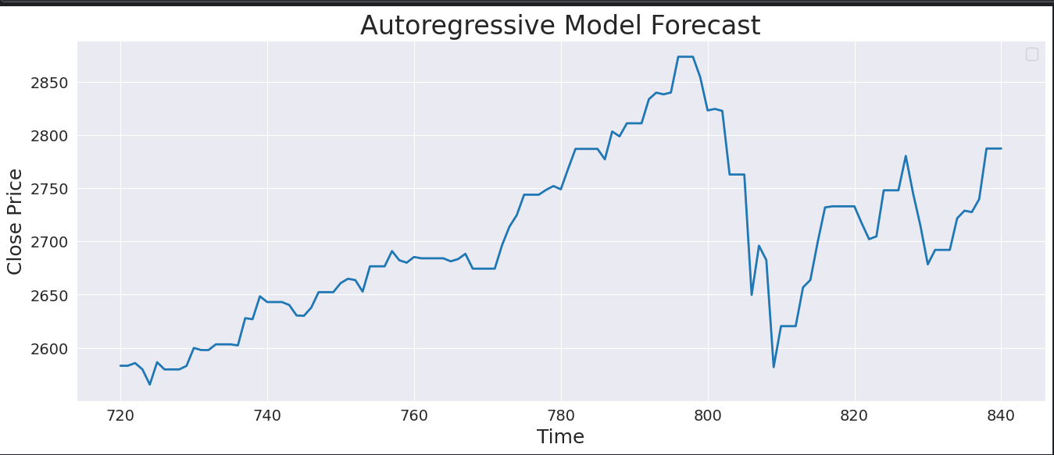

Slide 13
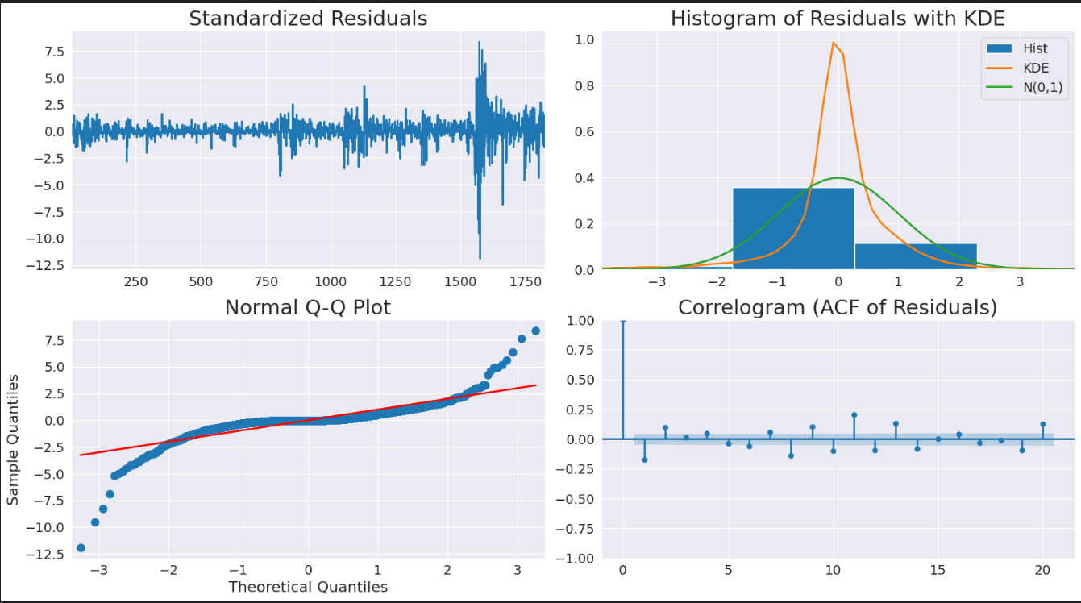

Slide 14

1. Residuals are evenly distributed: The model's errors are random and unbiased.
2. Residuals are approximately normal: The distribution is bell-shaped, but there might be a few outliers.
3. Q-Q plot shows some deviations: The residuals might have outliers.
4. No significant autocorrelation: The residuals are not correlated with each other.

Slide 15
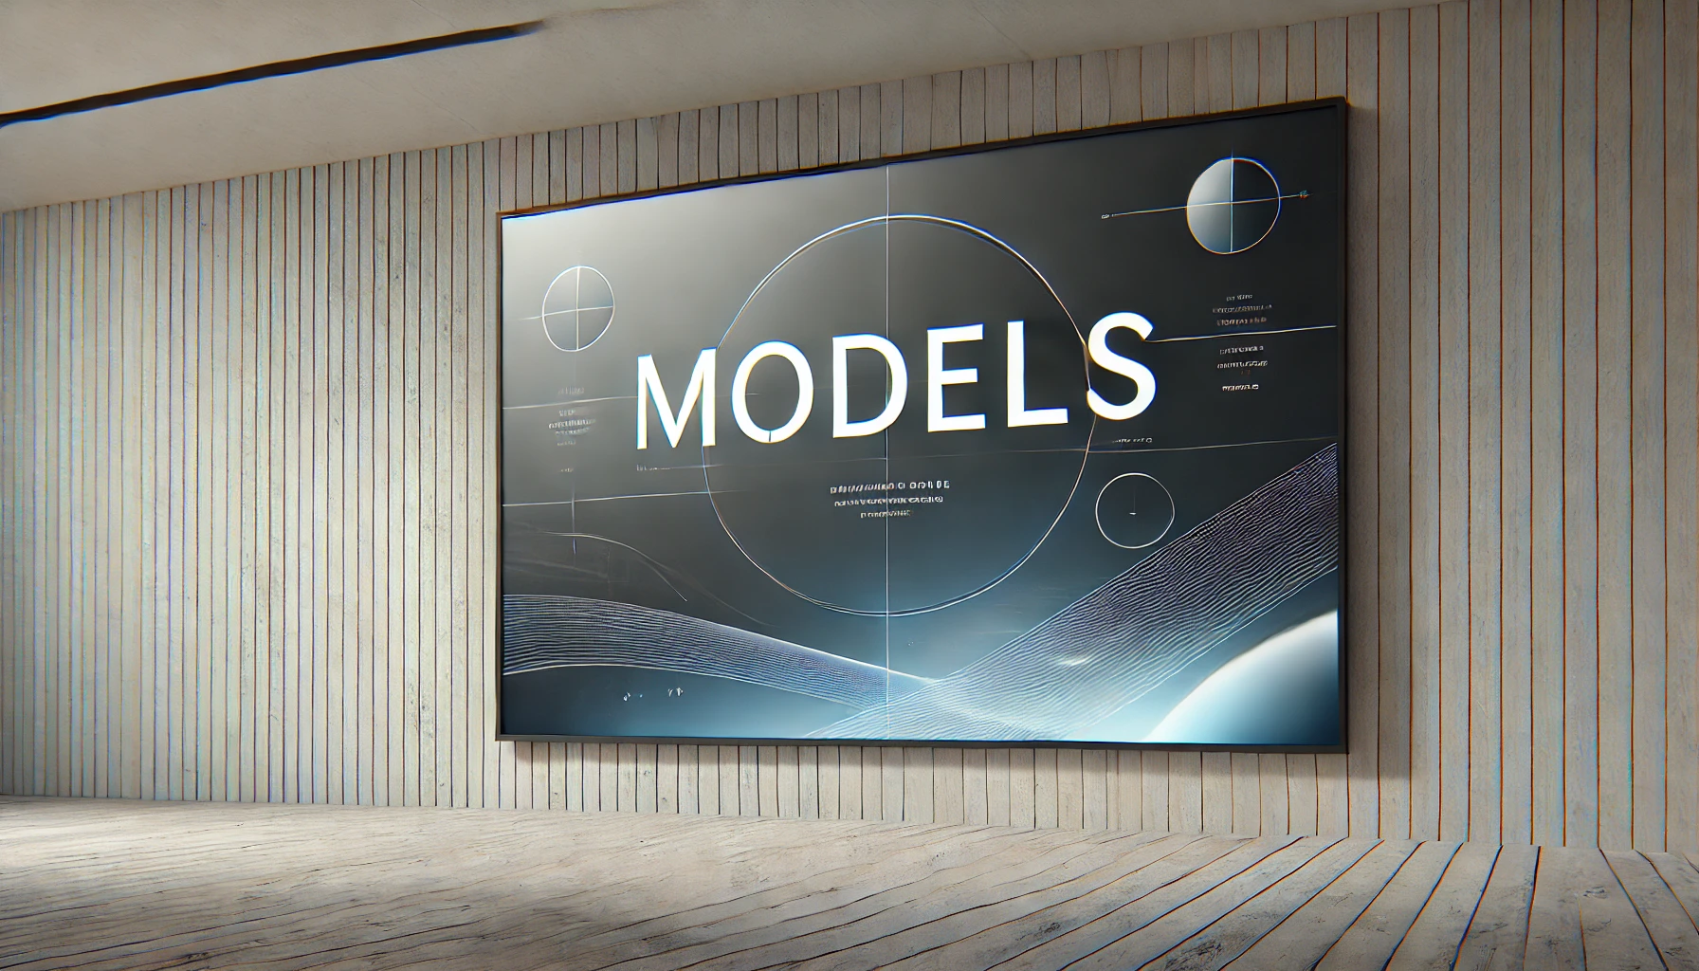

Models

Slide 16
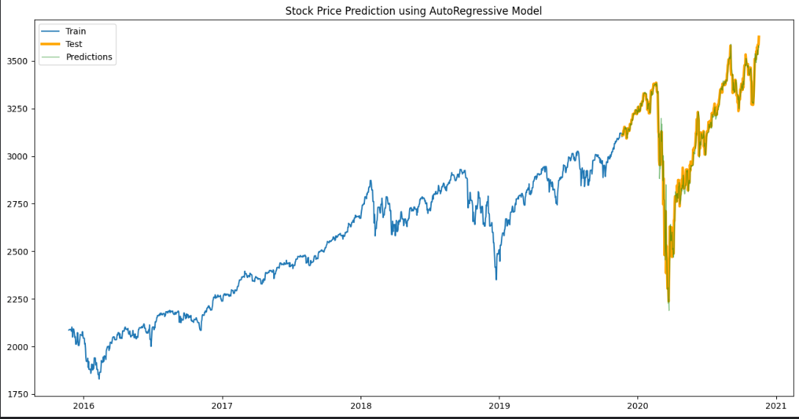

Slide 17
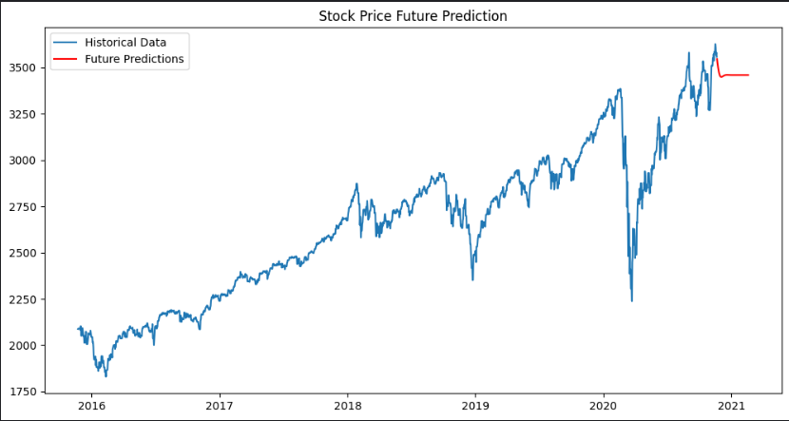

Slide 18
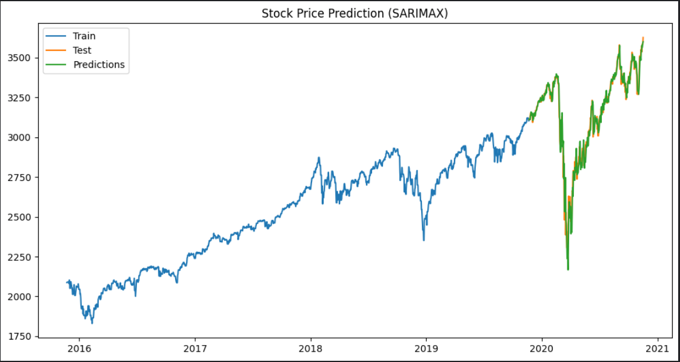

Slide 19
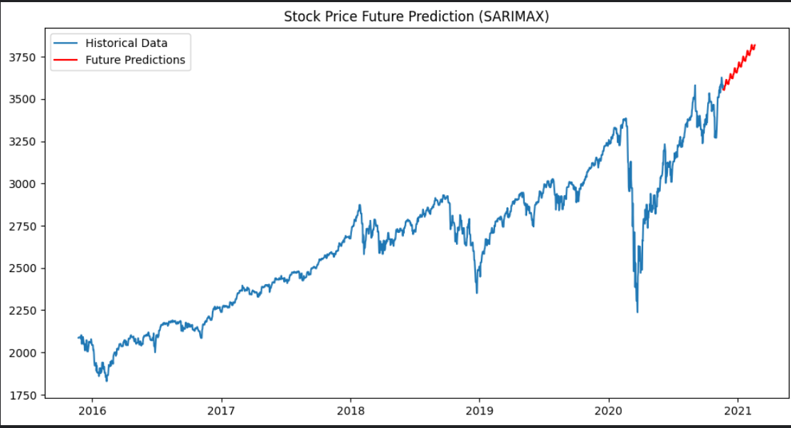

Slide 20
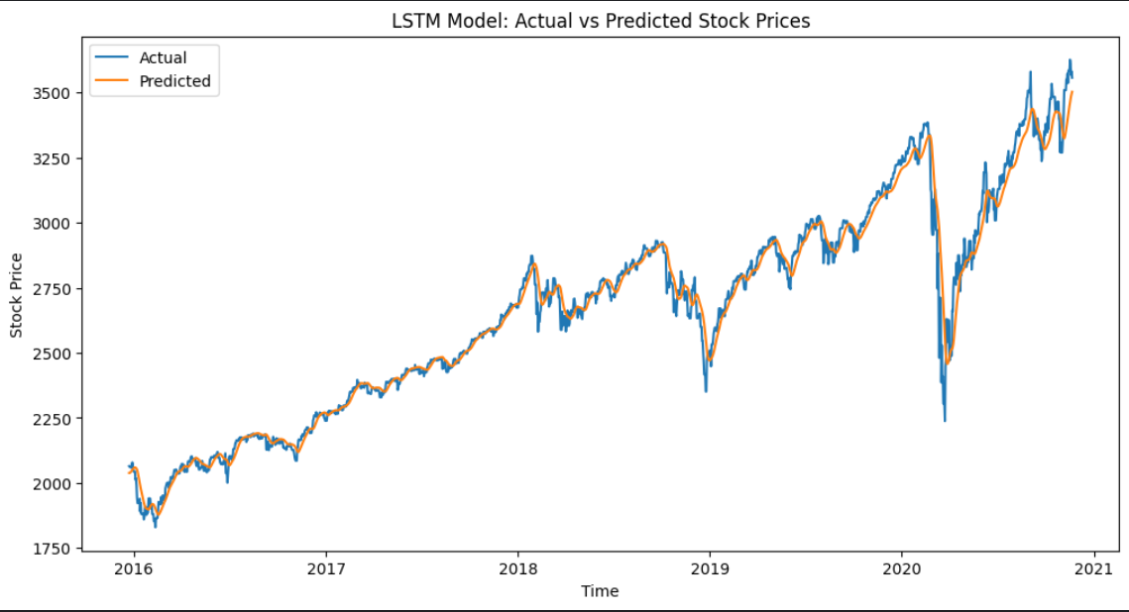

Slide 21
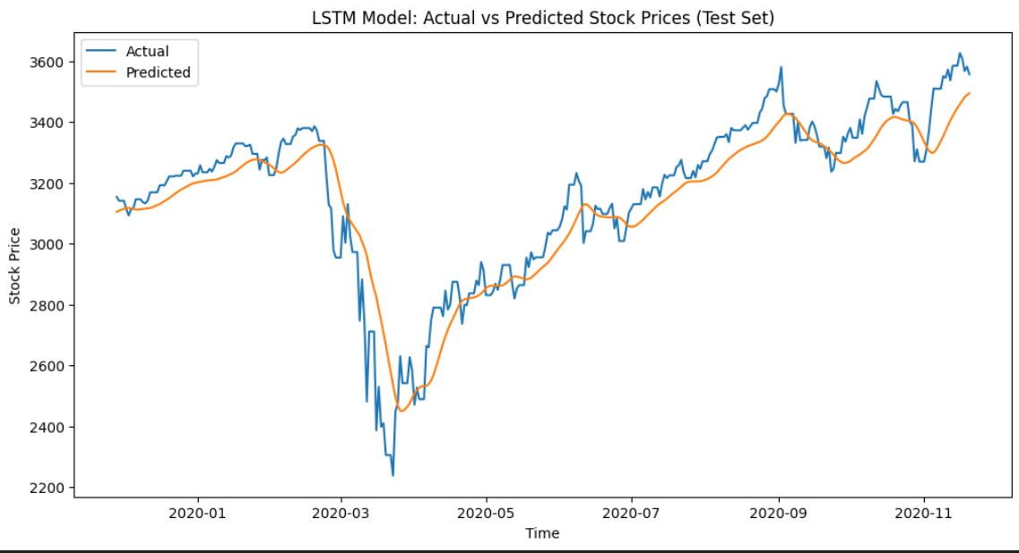

Slide 22
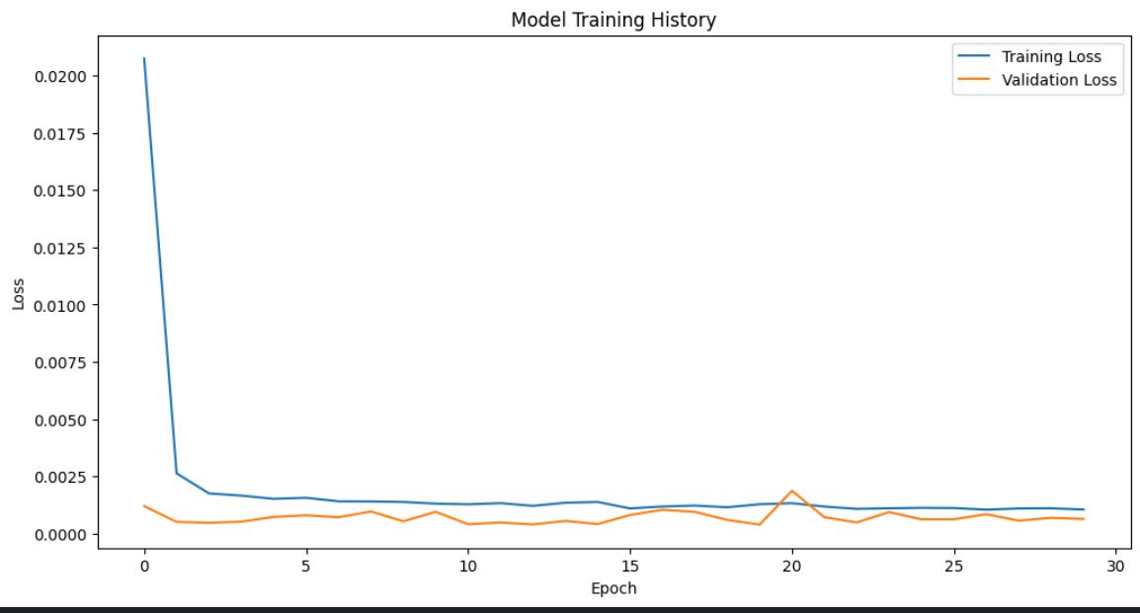

Slide 23
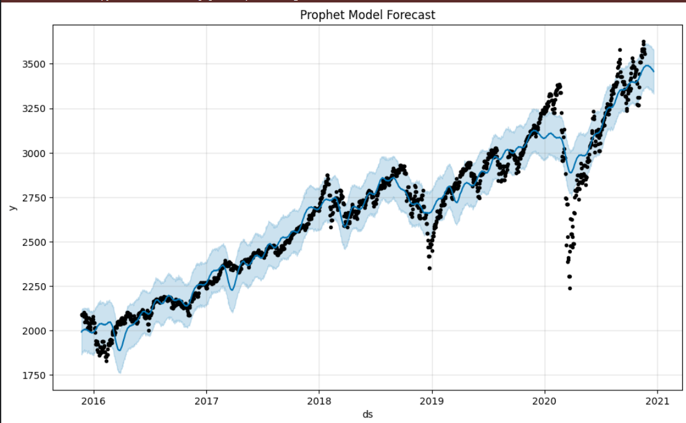

Slide 24
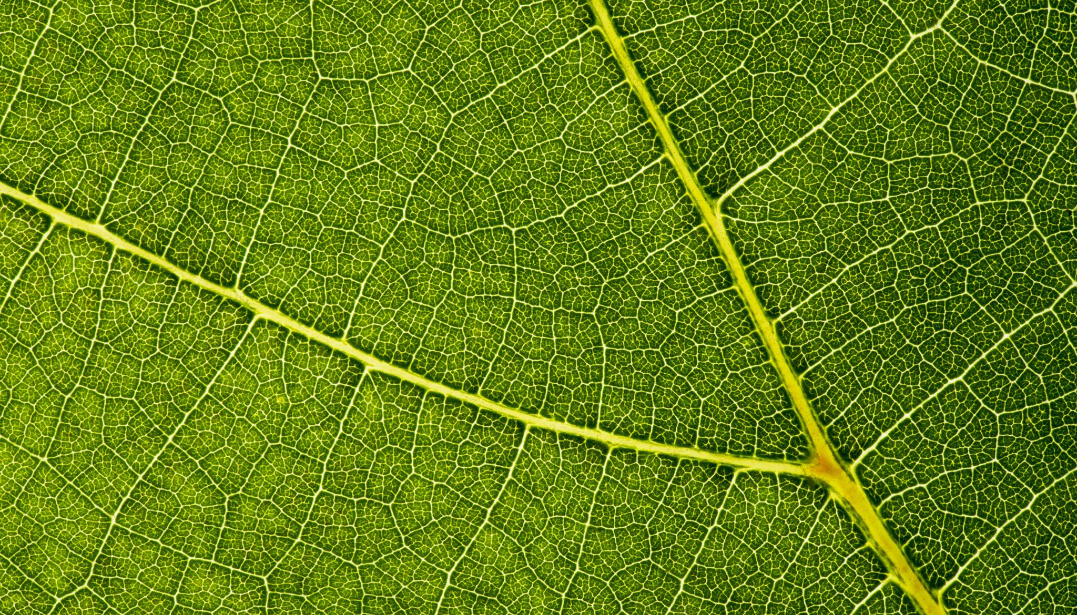
THANKS

